Slide 1


Slide 2


The Hitchhikers Guide To Building Better Azure ARM Templates
Eldert Grootenboer
Notes:
Rustig praten
Intonatie
Korte intro
Slides korte teksten

Slide 3


Eldert Grootenboer
@egrootenboer
Notes:
Technology Lead Azure & Integration

Slide 4

Introducing Boskalis

Slide 5










Cloud native strategy
Platform
Event Grid
Logic Apps
Functions
Manage all events that can trigger code or logic
Design workflows and orchestrate processes
Execute your code based on events you specify
API Management
Container Instances
Application Insights
Scalable API gateway for securing, publishing, and analyzing APIs
Run application containers in the cloud with a single command
Extensible Application Performance Management service
Database
Storage
Security
IoT
Analytics
Intelligence
Notes:
Pay as you go
Infinite scale
Don’t do infrastructure anymore

Slide 6

Infrastructure as Code

Slide 7
Infrastructure as Code (IaC) is the management of infrastructure (networks, virtual machines, load balancers, and connection topology) in a descriptive model, using version control to store the files.
Notes:
Or said another way. IaC is taking the environment upon which you intent to run your application and codifying it. The code is stored in version control and acted on using a CI/CD pipeline. No manual steps are taking in the portal to provision an environment.

Slide 8
Why Infrastructure as Code
Review changes
Cattle, not pets
Consistency
Reduce human error
Quickly set up environments

Slide 9

IaC on Azure
Notes:
7

Slide 10
Various options
Azure Resource Manager Templates (ARM)
Azure CLI
PowerShell
Code (SDKs)
Terraform
Ansible
Chef
Puppet
Bicep

Slide 11
Benefits of ARM
First class citizen
Desired-state deployment
Idempotent
Faster deployments
Modular
DevOps
Extensible
Tracked deployments
Easy authoring

Slide 12
Template structure
{
"$schema": "https://schema.management.azure.com/schemas/2019-04-01/deploymentTemplate.json#",
"contentVersion": "1.0.0.0",
"parameters": {},
"variables": {},
"resources": [],
"outputs": {},
"functions": []
}
Notes:
Describe the various fields

Slide 13

Quickstart Templates
Notes:
https://github.com/Azure/azure-quickstart-templates
https://github.com/Azure/azure-quickstart-templates/blob/master/101-cosmosdb-mongodb/azuredeploy.json

Slide 14

Authoring
Notes:
17

Slide 15
Visual Studio Code
ARM Templates extension and language
Intellisense
Syntax highlighting
Snippets
Schema validation
ARM Template Viewer

Slide 16
Bicep
DSL
Declarative
ARM JSON as Intermediate Language
Full feature parity

Slide 17

Building Better Templates
Notes:
12

Slide 18

The ultimate ARM template
Use language constructs
Re-use templates
Under source-control
Notes:
Utilize available language constructs to maximize the impact of minimal code
One Template for n Scenarios – achieving the right balance based on the life cycle of the resources (i.e. don’t just put everything in the same template)
Under Source Code Control 😉 (With unit tests (parameter files))

Slide 19
ARM templates
Parameterized
Idempotent
Outputs

Slide 20
Parameterization
Parameters and variables
Using objects
Minimize parameters, use variables
Unique values
Using a parameter file
Default values
Restrictions
Optional parameters
Notes:
Parameters Add Flexibility
Minimize options for parameters

Slide 21
Simple or complex resources
Sequencing
Nesting
Linking
Looping
User-defined functions
Tags and locks
Switch / case statements

Slide 22
Best practices
Don’t overuse parameters
Use well-chosen defaults
Utilize variables for re-use
Apply tags from templates
Dynamically retrieve secrets and settings
Use modular templates
Simplify through user-defined functions

Slide 23
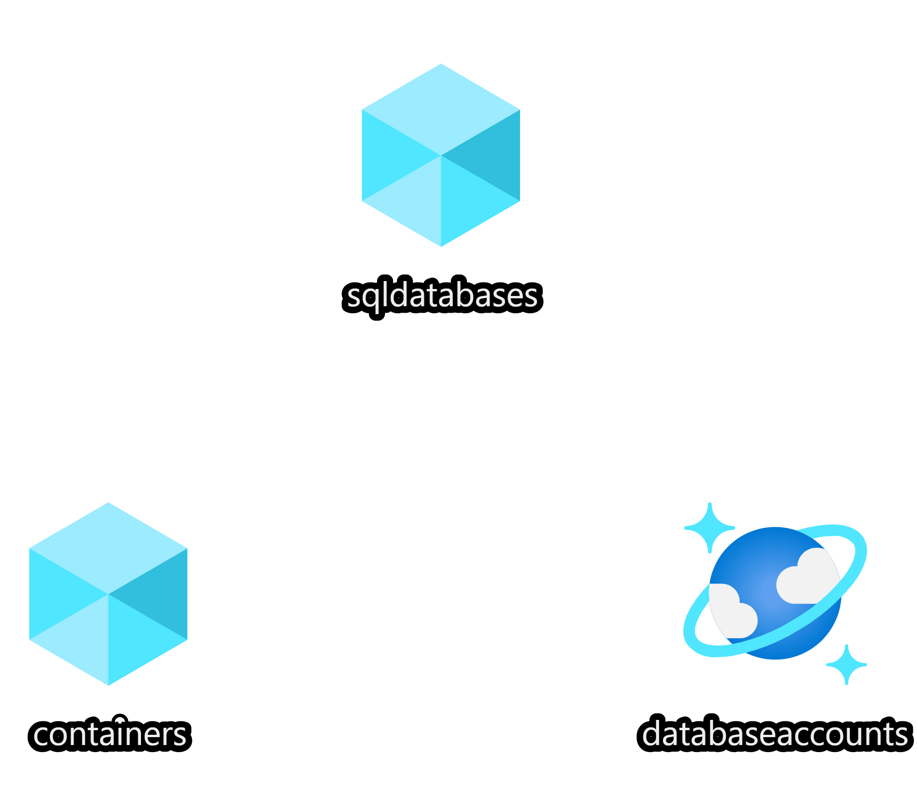
Demo
Notes:
20
demo-2-authoring-templates
Show templates
Deploy using PowerShell

Slide 24

From portal to template
Notes:
25

Slide 25
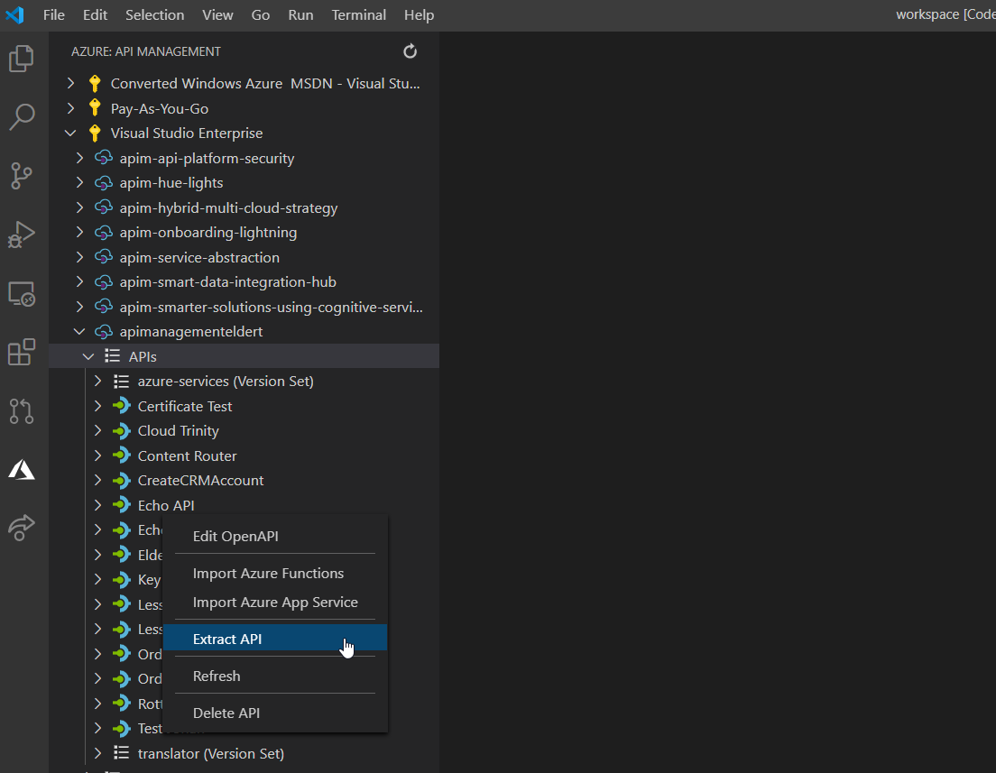
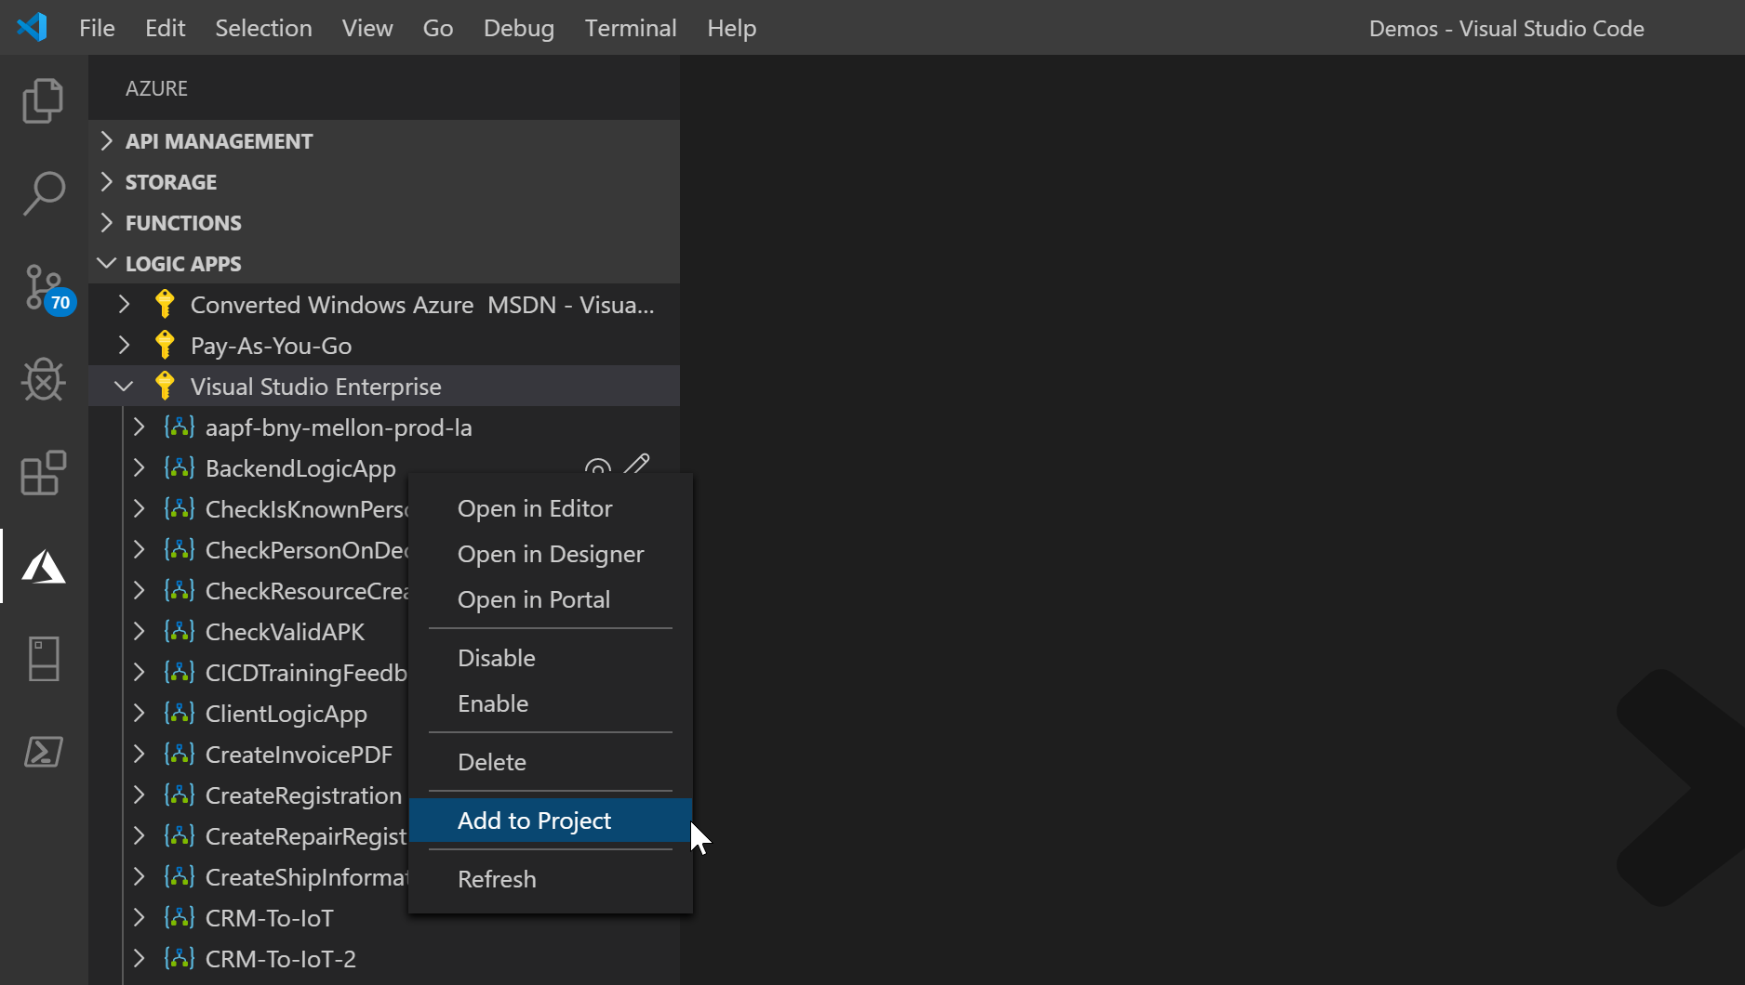
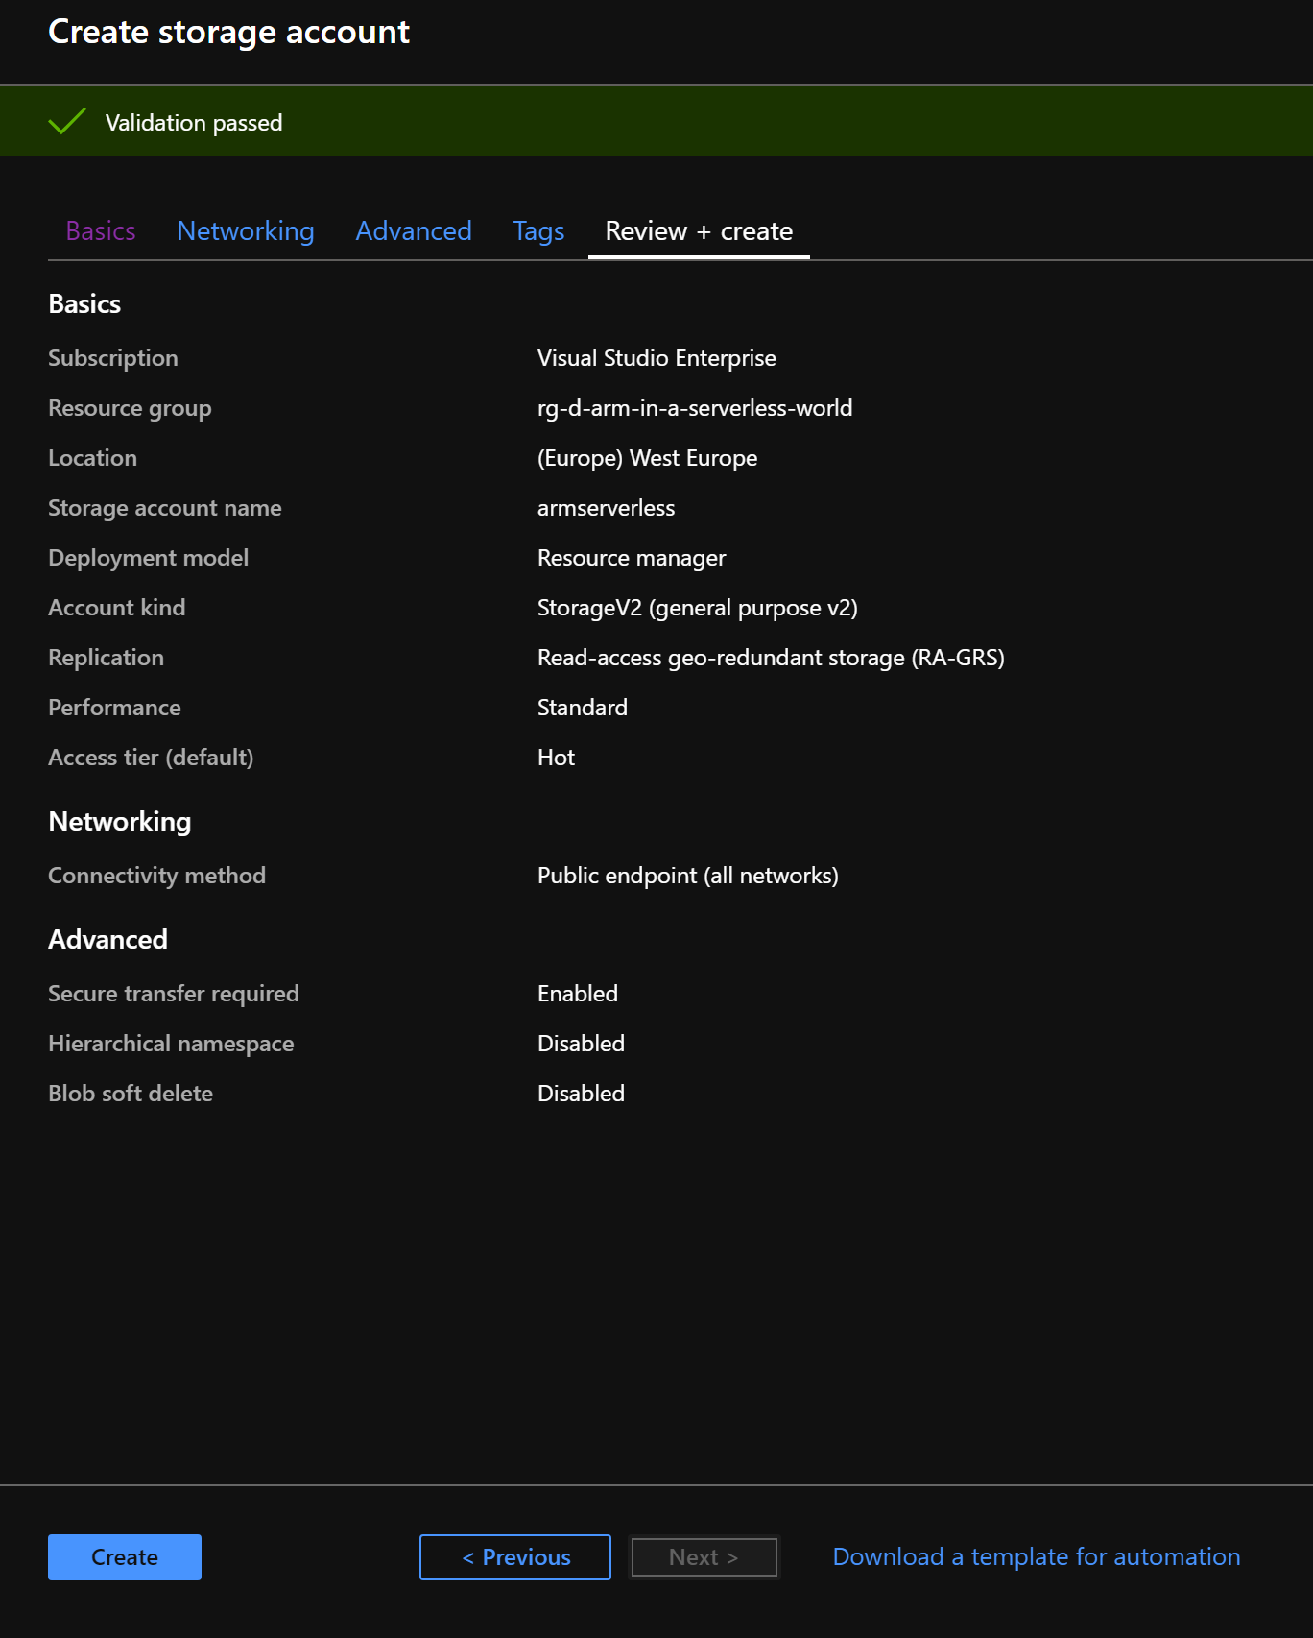
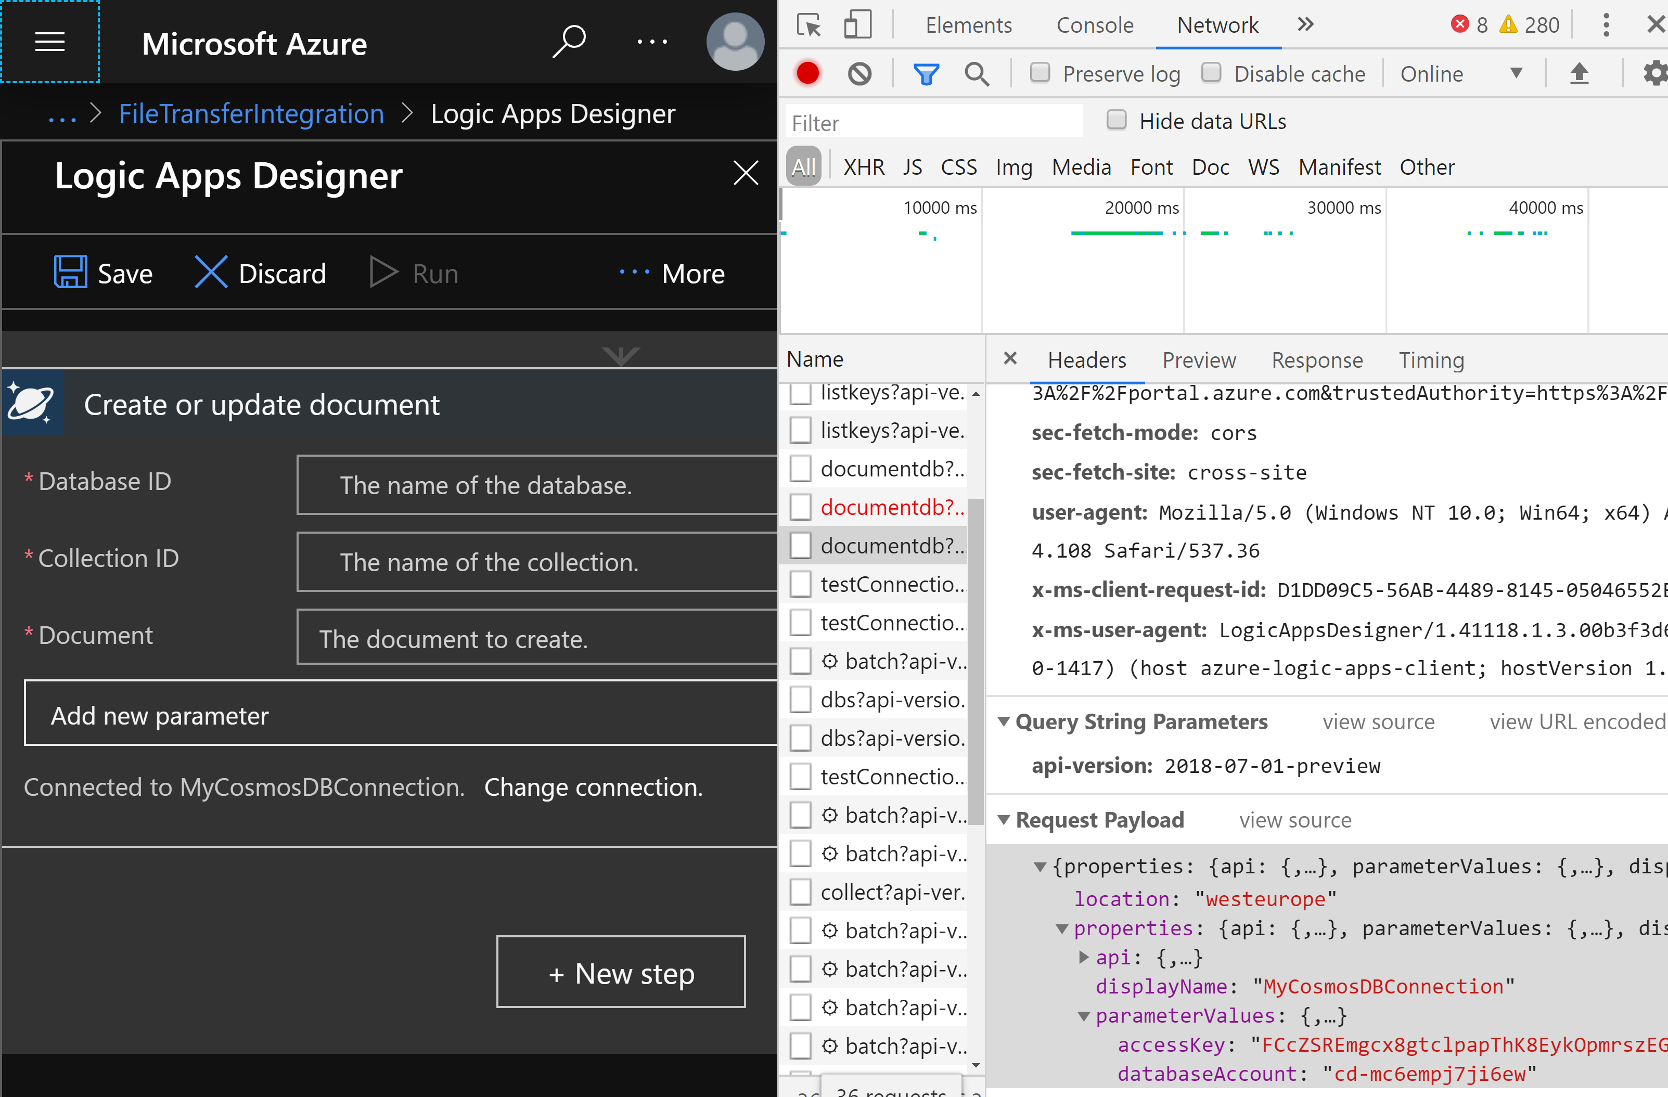
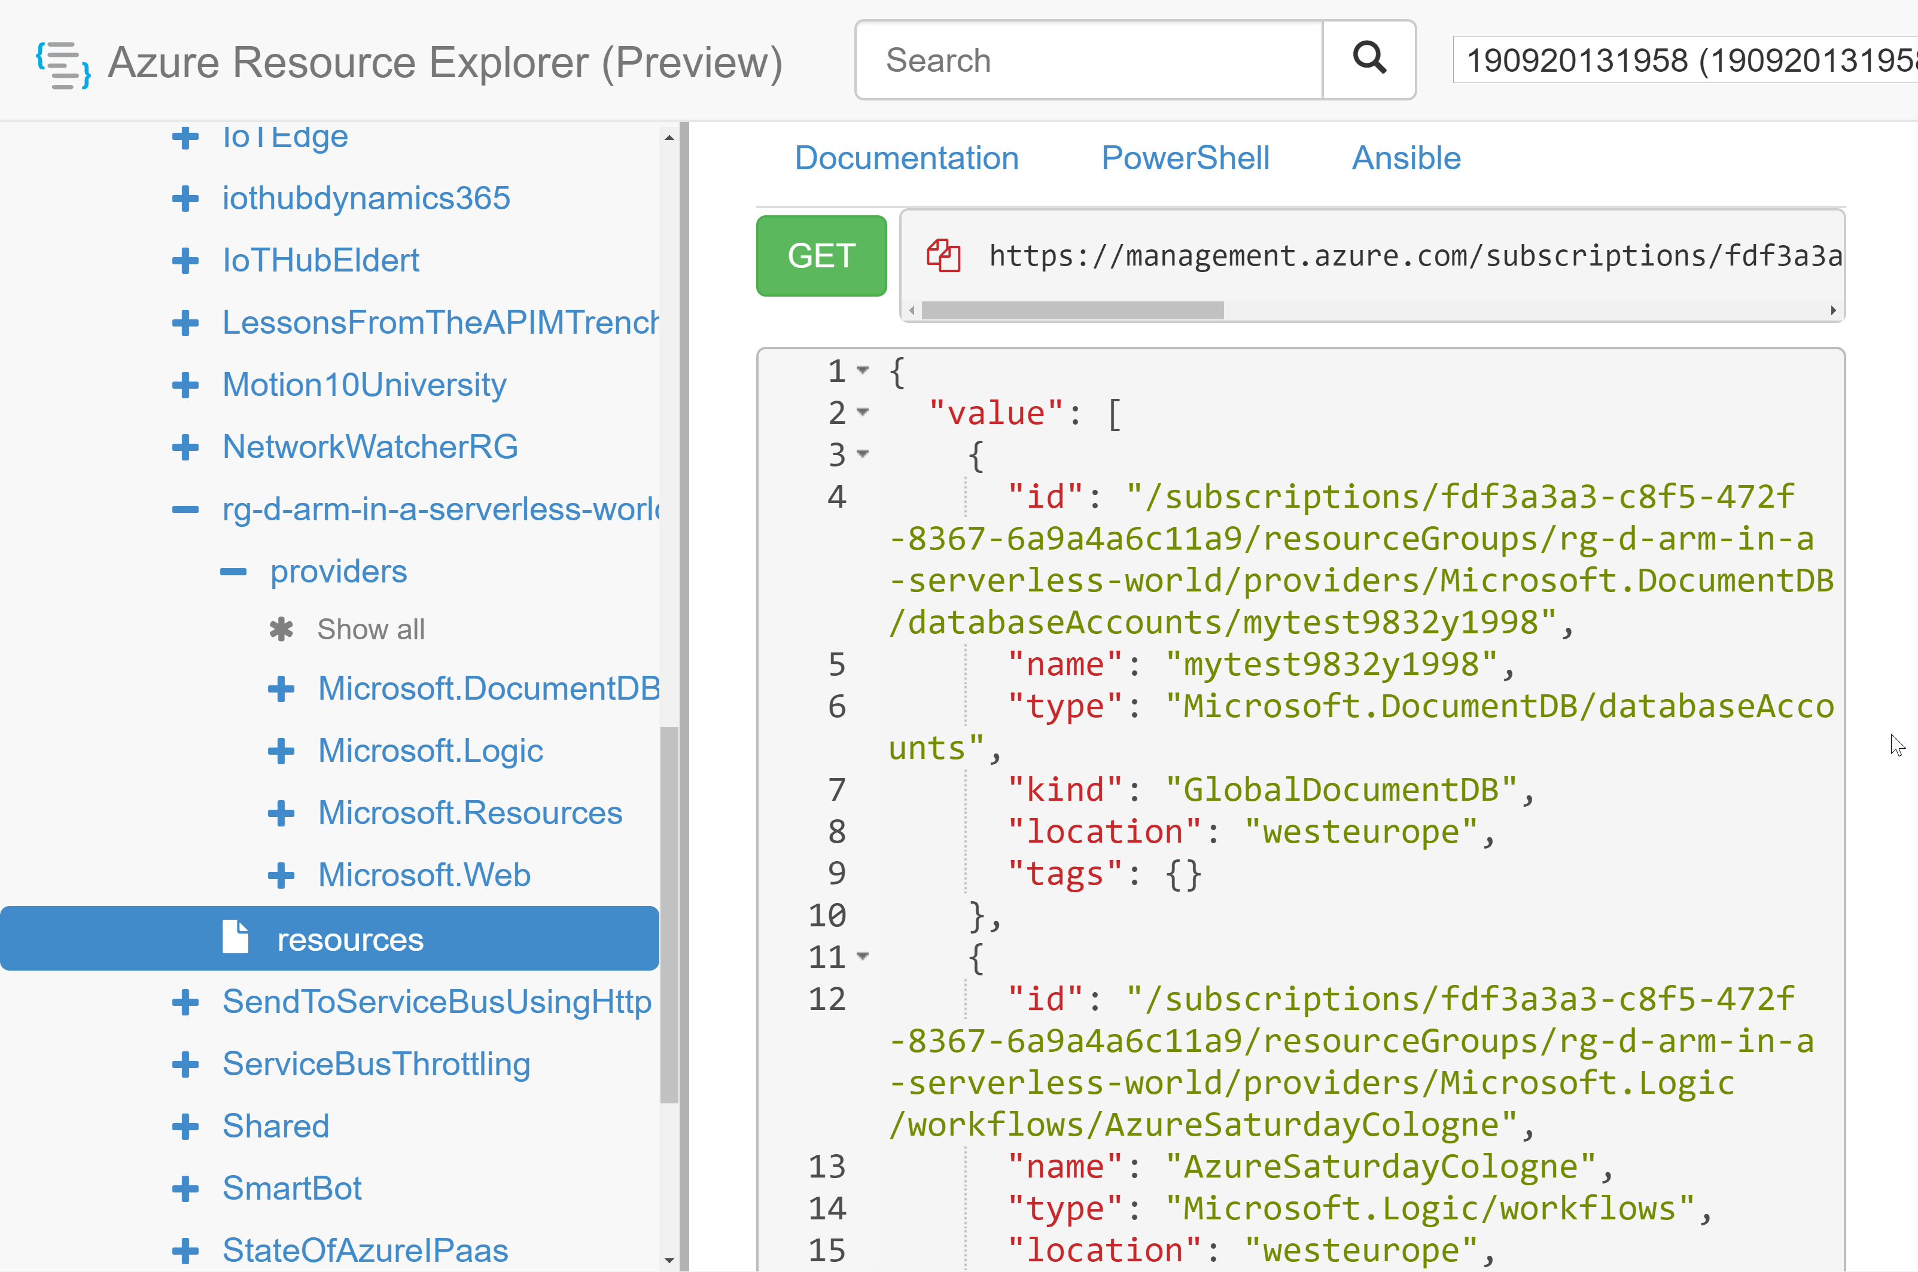
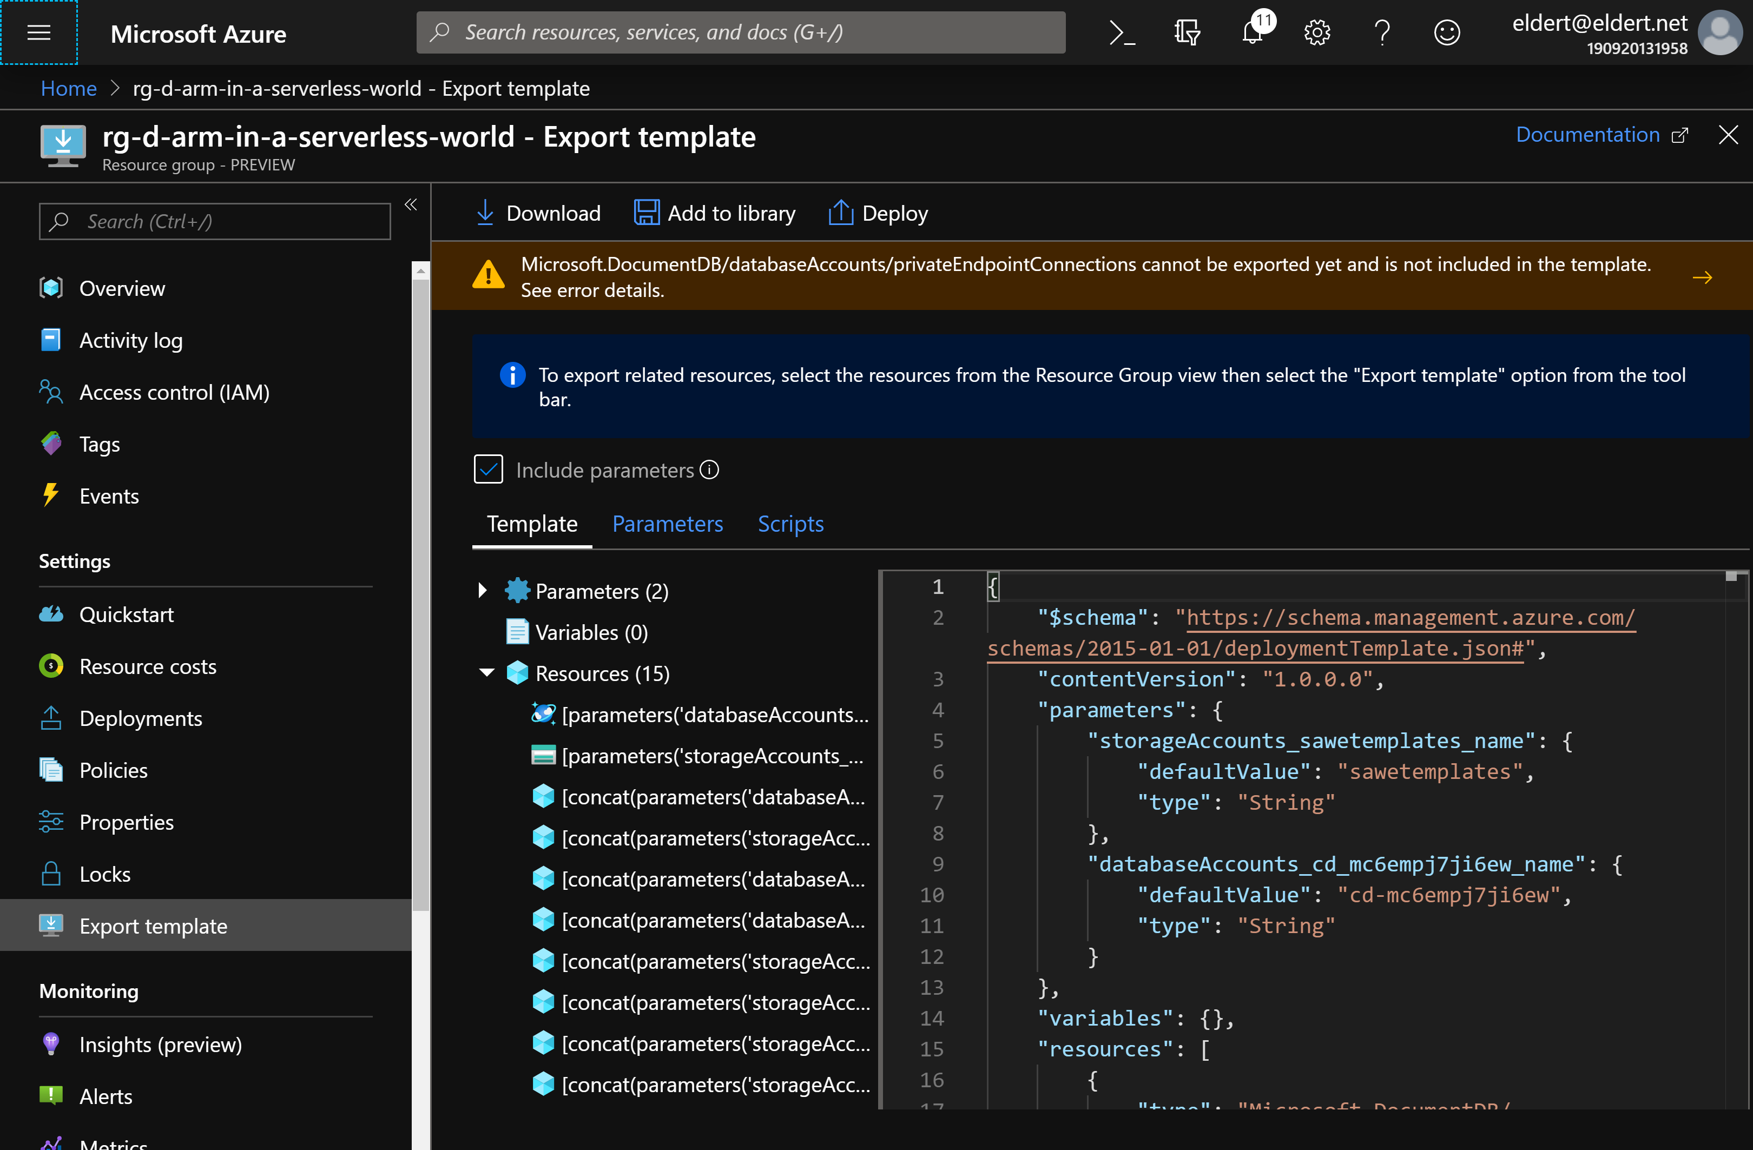
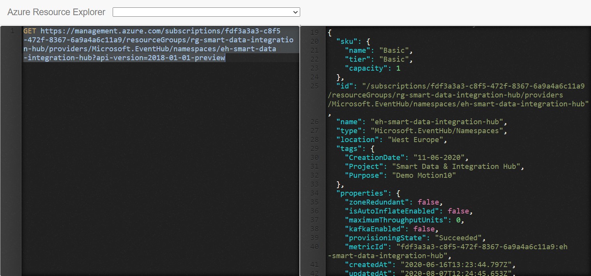
Extracting templates
Portal
Creation
Resource Explorer
REST
Debug tools
Tools
API Management
Logic Apps
Notes:
Many tools available

Slide 26
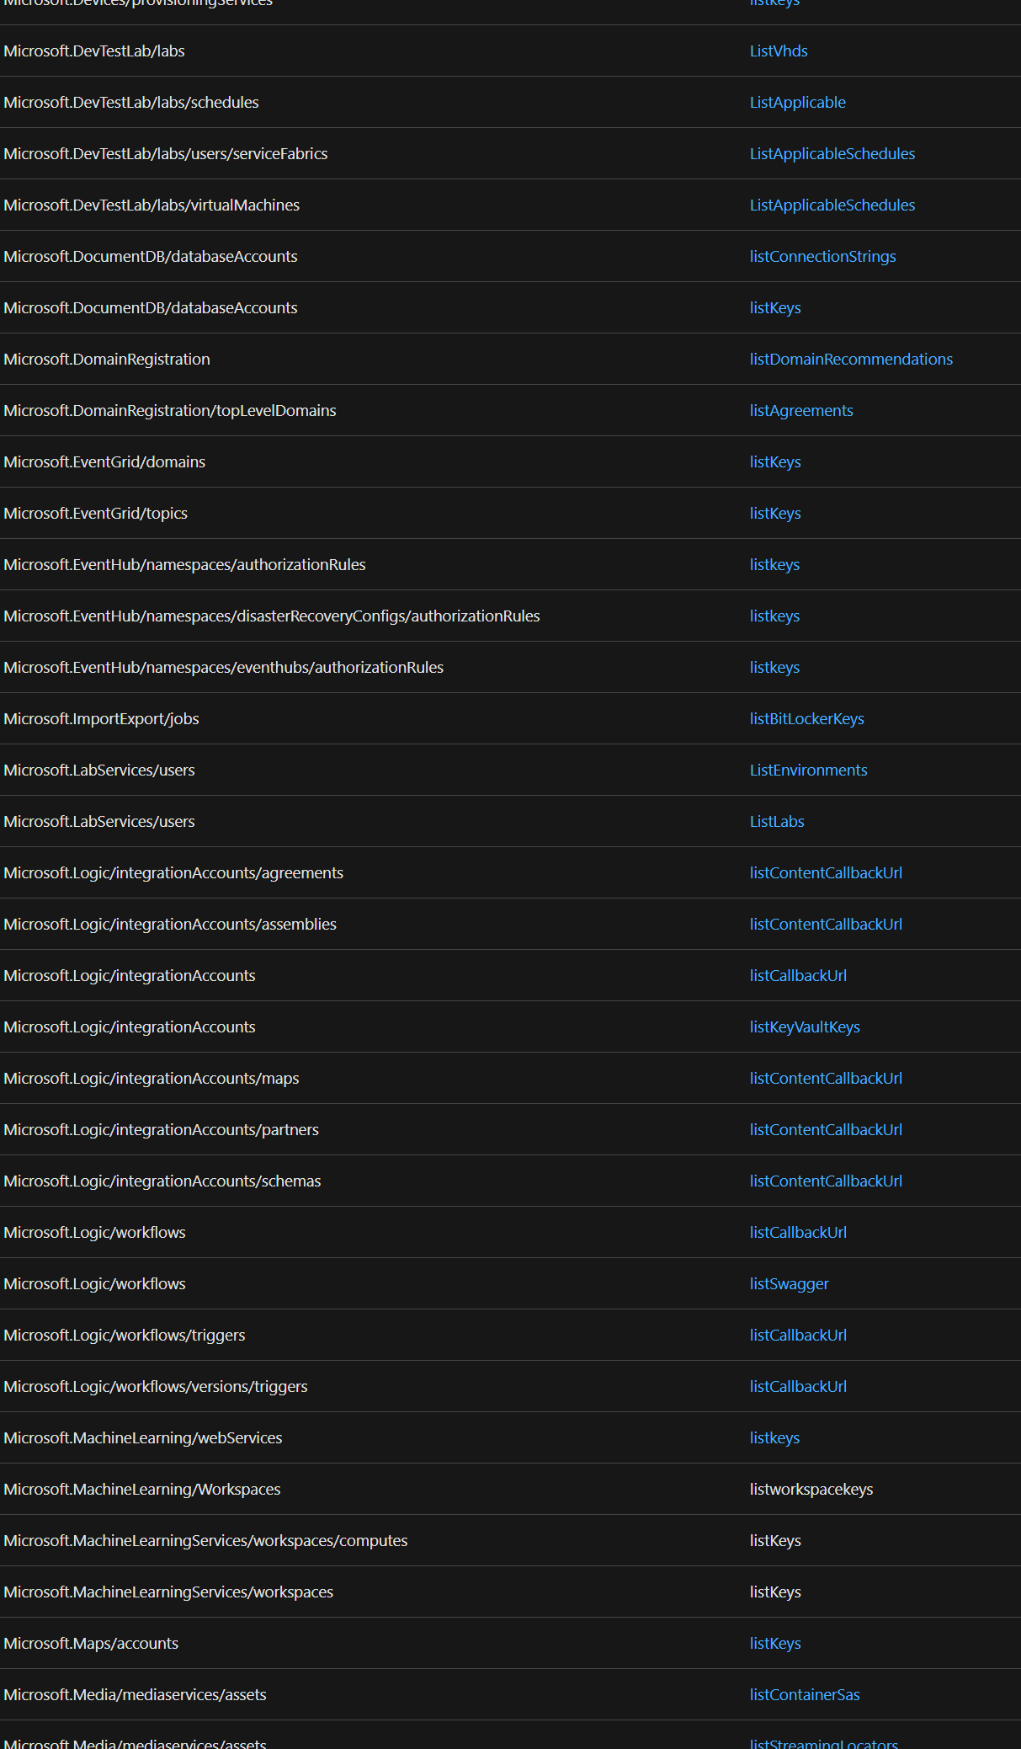
Secrets in templates
Securestring
Listkeys
Listsecrets
Key Vault
How about other settings?
List*
Reference
Notes:
We now have our template, but how do we make it more secure?

Slide 27
Deployment
Portal
PowerShell
Azure DevOps
GitHub
Notes:
Our template is now ready, how can we get it into our environments?

Slide 28
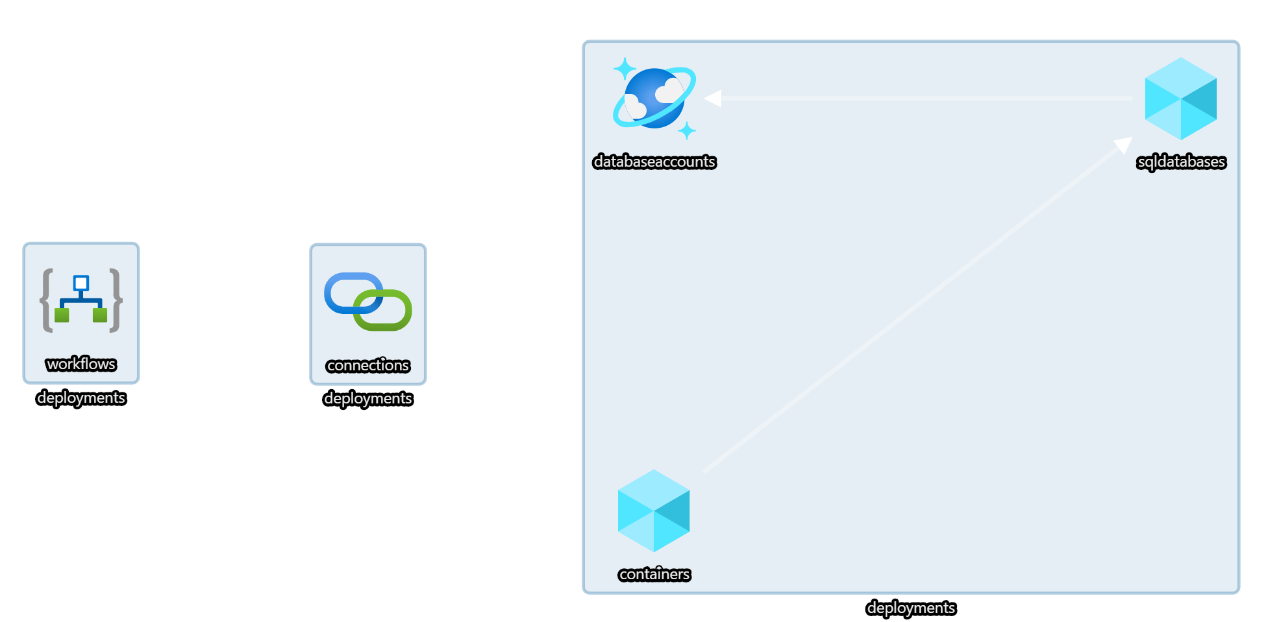


Demo
Notes:
30
demo-3-deployment
Show templates and pipelines
Show deployment using Azure DevOps (change something, check-in, sync)

Slide 29

Quality assurance
Notes:
40

Slide 30
What-If
Calculates desired state
Retrieves current state
Noise suppression service
Calculated diff

Slide 31
Azure Resource Manager Template Toolkit
Static Analysis
Guidelines & best practices
Pipeline tasks

Slide 32
Deployment script
Run arbitrary script
Replace scripts in pipeline
Think idempotently

Slide 33
Template specs
Store and share templates
Resource in Azure
Versioned
No public endpoint needed

Slide 34

Demo
Notes:
39

Slide 35

Almost done…
Notes:
55

Slide 36
Take aways
Use language constructs
Follow best practices
VS Code is your friend
Keep improving quality

Slide 37
Resources
New to ARM: https://bit.ly/azure-arm-get-started
Quickstart templates: https://bit.ly/azure-arm-quickstart-templates
GitHub: https://bit.ly/azure-arm-quickstart-templates-github
Visual Studio Code Extensions: https://bit.ly/azure-arm-vscode-extensions
Template Toolkit: https://bit.ly/azure-arm-template-toolkit
What-If: https://bit.ly/azure-arm-what-if
Deployment scripts: https://bit.ly/azure-arm-deployment-scripts
Bicep: https://bit.ly/azure-arm-bicep
Best practices: https://bit.ly/azure-arm-best-practices

Slide 38

We need your feedback!
https://forms.office.com/r/KD4k72rcJJ

Slide 39



Thank You!
@egrootenboer
eldert@eldert.net
https://www.linkedin.com/in/eldert-grootenboer

